Slide 1
Baby Cry Detection using AI and Signal Processing
Pritam Kesh

Slide 2
Contents
Problem Statement
Objectives
Methodology
Results
Conclusion
Scope and Limitations

Slide 3
Problem Statement
Today’s baby monitor device is not accurate to monitor baby cry because of lot false detection. There is no intelligent system in the market to detect infant cry accurately. In order to overcome false detection a system needed to design for detect infant cry accurately.
The proposed system is build with signal processing and Artificial neural network algorithms with model accuracy is 98%.

Slide 4
Problem Statement
To cater the consumer needs, a healthcare beta product is in development for delivering very good primary baby video monitoring performance. Now to deliver it’s one of the features is to detect baby’s cry. It is important to detect it with higher accuracy with real time data which has obstacles such as different background noises. The long-term objective to solve it in a single model manner, so that it can be mounted inside the device chipset, and the model can be deployed inside the device.

Slide 5
Objectives
The key objective of this research project is to develop a robust system that can accurately identify and detect infant crying sounds based on raw audio signals. The system will be designed to leverage advanced signal processing and deep learning techniques to extract relevant features from the audio signals and to classify them into distinct categories. The use of raw audio signals for cry detection eliminates the need for complex signal pre-processing steps, which can introduce noise and degrade the quality of the audio signal.

Slide 6
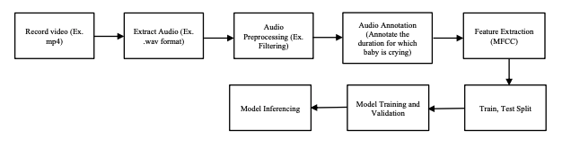
Methodology
Methodology divided in two parts:
Deep Learning Model Building (ANN and CNN)
Application development using Python/Flask/HTML/CSS/JQuery for testing the application of the implemented model

Slide 7
CNN Model Building
Dataset
Dataset consist of baby cry recordings and non-baby cry recordings(all sounds except baby cry)
Two classes
Baby cry
Non-baby cry

Slide 8
Audio Signal Preprocessing
AUDIO DATA
Baby cry audio
Non-baby cry audio
MFCC
MFCC
Label baby cry target as 1
Label non-baby cry target as 0
MODEL

Slide 9
MFCC
MFCCs are the Mel Frequency Cepstral Coefficients.
MFCC takes into account human perception for sensitivity at appropriate frequencies by converting the conventional frequency to Mel Scale, and are thus suitable for speech recognition tasks.
The Mel scale relates perceived frequency, or pitch, of a pure tone to its actual measured frequency. Humans are much better at discerning small changes in pitch at low frequencies than they are at high frequencies. Incorporating this scale makes our features match more closely what humans hear.
We generally take 12-13 Mel Frequency coefficients into consideration as features when training models.

Slide 10
Steps Involved in finding MFCC Coefficients
Raw signal
Split the signal into frames
Apply fft to get periodogram of each frame
Apply triangular filter to periodogram to get filter bank coefficients
Apply DCT to filter bank coefficients to get 13 MFCC coefficients
Selecting 13 MFCC coefficients

Slide 11
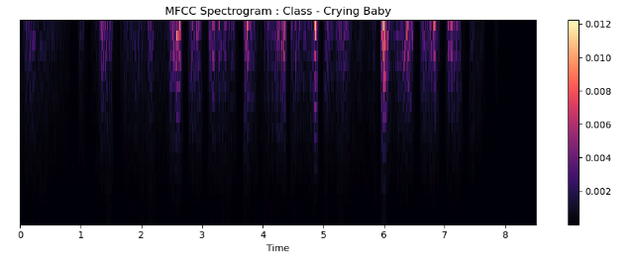
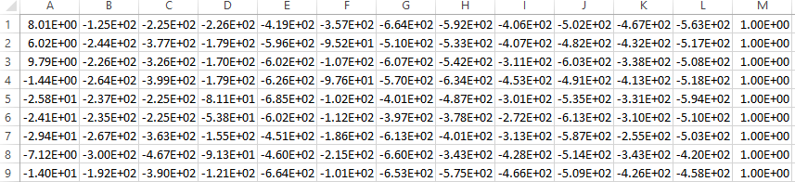
MFCC Output

Slide 12
CNN
Models in Keras are defined as sequence of layers
The first hidden layer was set to be 64
The second layer was set to be 32
The output layer was set to be 1
the sigmoid activation function was used for the third layer, which is the output layer.
Sigmoid was used to achieve a binary output, it ensure that the output is between 0 and 1
Learning rate is 0.0005 with optimizer Adam( update network weights iterative based in training data.).

Slide 13
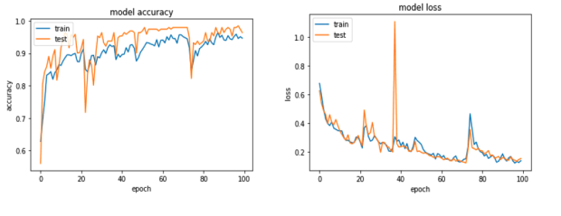
CNN Model Accuracy Results
The training accuracy, indicated by the blue label, is 98%, while the test accuracy, indicated by the orange label, is 96.3% after 100 epochs. The model's training and test accuracy increase gradually at each epoch. Furthermore, the difference between the training loss and testing loss gradually reduces and reaches a minimum at the final epoch.

Slide 14
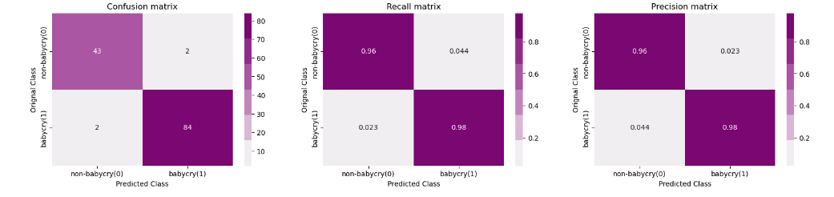
CNN Model Classification Report

Slide 15
Comparing Different Model Performance
Models | Training Accuracy | Testing Accuracy
ANN | 96% | 91%
CNN | 99% | 98%

Slide 16
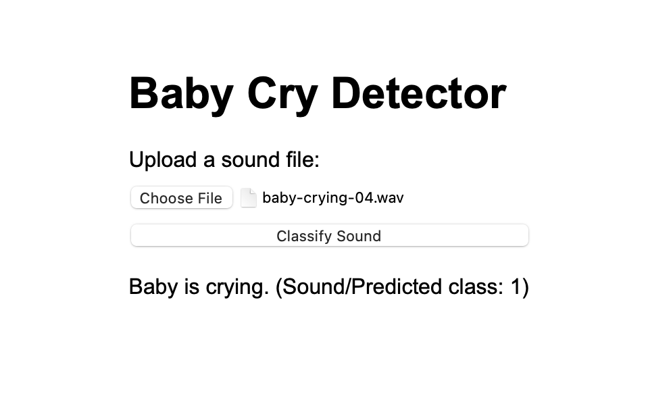
Demo 1
Application Demo – With audio data files.

Slide 17
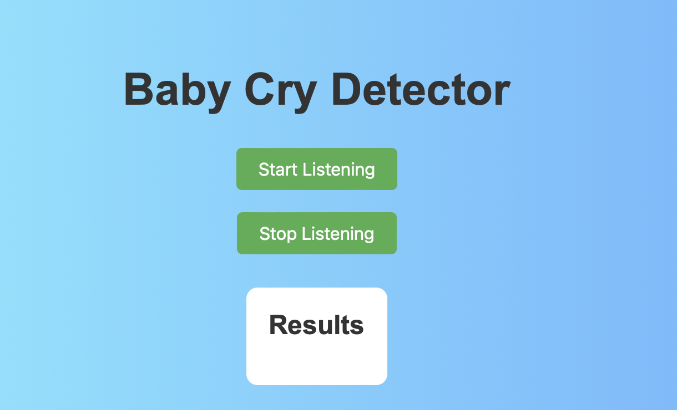
Demo 2
Application Demo – Real Time Testing with live audio listening capabilities.

Slide 18
Conclusion
The primary objective of this thesis is to create a system that can accurately detect instances of baby crying. This overarching goal is accomplished through a series of three specific objectives. The first objective involves training the system using a custom-built convolutional neural network. The second objective entails integrating a pre-trained version of the model into a real-time testing application. Finally, the third objective aims to develop a notification alert that is triggered whenever a cry is detected by the system. Upon detecting a crying baby, the system generates a notification to alert.

Slide 19
Scope & Limitations
Deploying this in mobile application.
This system can be integrated in many ways to show output.
Like play a music when baby cries
Video monitoring.
The limitations of the system is high sensitive to loud noise(false alarms).

Slide 20
Thank you

